Slide 1
“Fuzzy Logic”

Slide 2
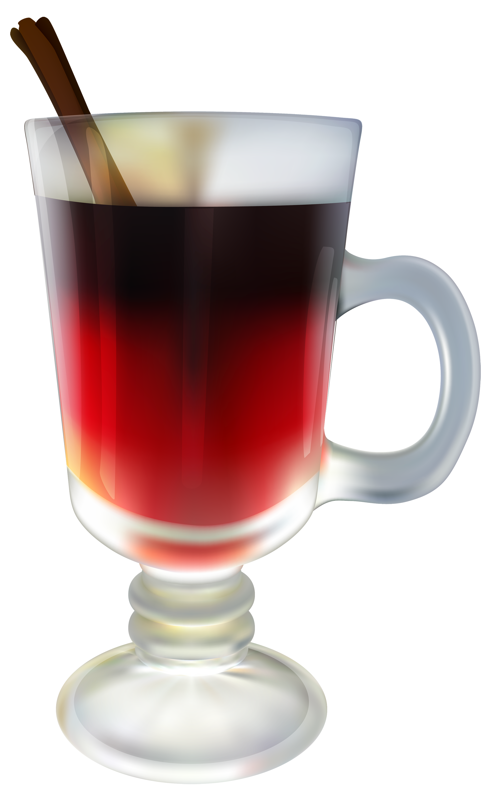
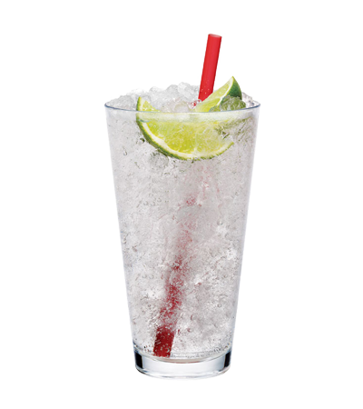

Fuzzy Logic VS Traditional Logic
Boolean
Fuzzy
0
0
0.7
1
1
1
IS IT HOT ??
Yes 1 Hot
No 0 Cold
This is not fare
1 0
This is fare

Slide 3

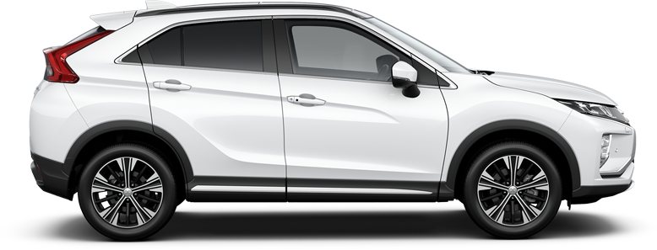
Let’s Create a System
Automatic Braking System

Slide 4
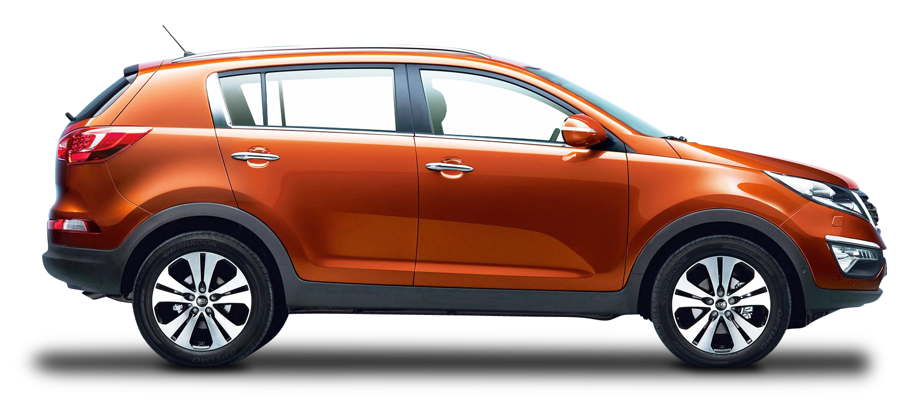
Automatic Braking System
Traditional Logic
IS Car Far ? Yes
Brakes ? No
Close
Far

Slide 5

Automatic Braking System
Traditional Logic
IS Car Far ? No
Brakes ? Yes
Close

Slide 6
Automatic Braking System
Fuzzy Logic
IS Car Far ? In Range 0 to 1
Brakes ? In Range 0 to 1
Close
Far

Slide 7
Automatic Braking System
Fuzzy Logic
IS Car Far ? 0.8
Brakes ? Slightly pressure
Close
Far

Slide 8
Automatic Braking System
Fuzzy Logic
IS Car Far ? 0.2
Brakes ? heavy pressure
Close
Far

Slide 9
Fuzzy Set
VS
Crisp Set
SPEED | Accelerate | Distance
FAST 1 | Accelerate 1 | FAR 1
Slow 0 | Brakes 0 | Close 0

Slide 10
Fuzzy Set
VS
Crisp Set
1
Very Close
Close
Far
0
Distance
1
Brakes
Constant
Accelerate
0
Accelerate
1
Very slow
Slow
Optimum
Fast
0
Speed

